Slide 1
Dayi Yang 11946047
Zhaochen Lan 12842050
Ji Teng 12449447
Longyong Li 13288220
Ios team 134

Slide 2
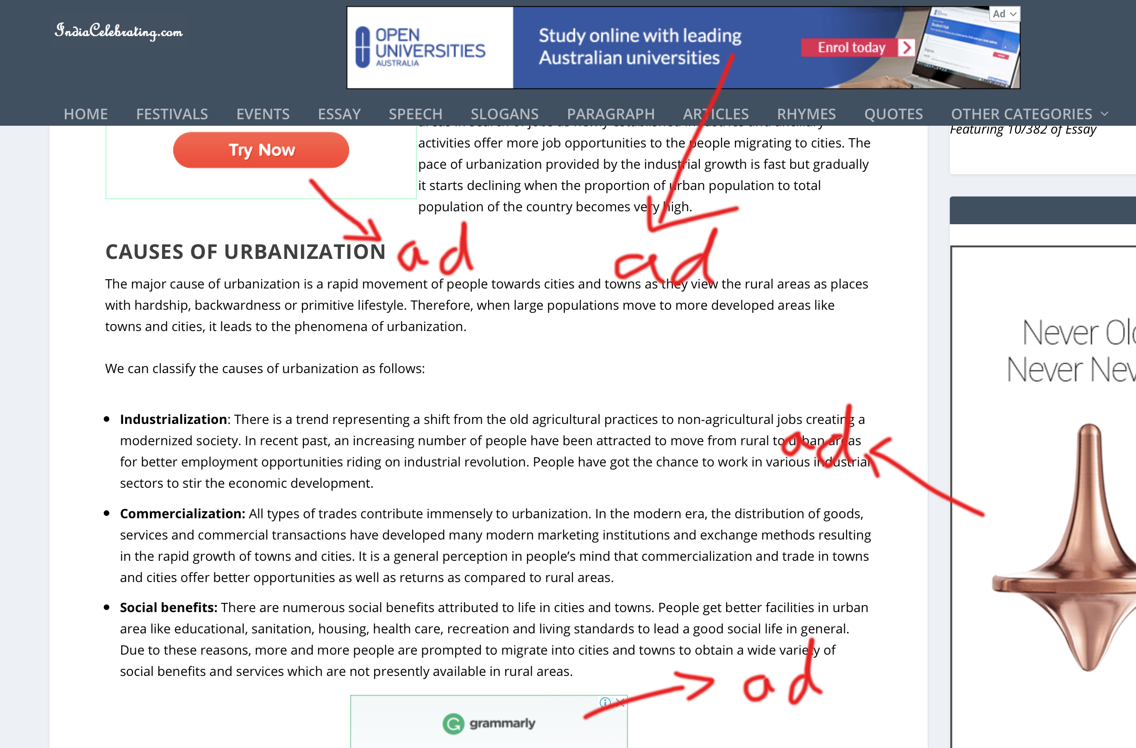
Did you meet this problem when browsing?

Slide 3
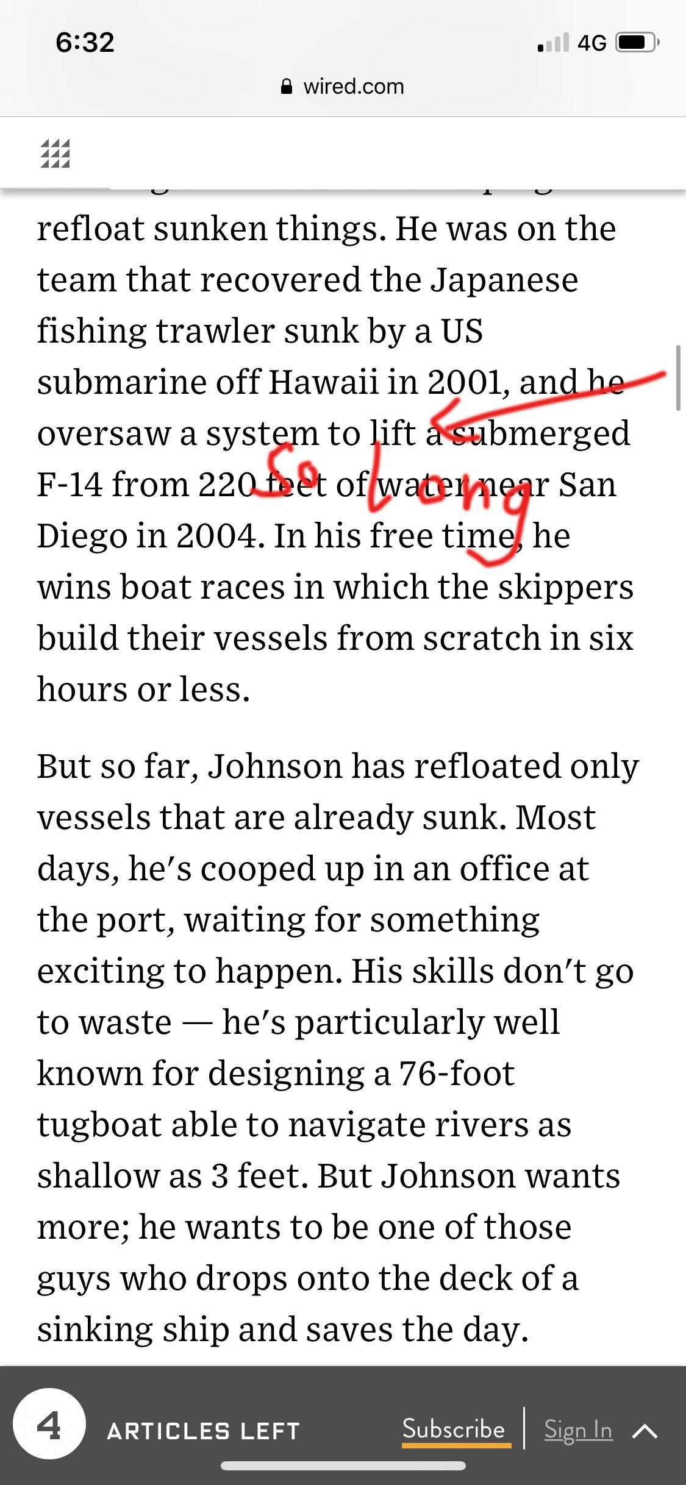
Did you meet this problem when browsing?
The article is too long, when you interrupt and want to start reading again, do you know where to start?

Slide 4

Existing browsers can't give us a good reading experience!

Slide 5
Do you want an App that
Can eliminate ads and useless information?
Can store the location you read?
Make browsing as elegant as reading a book？

Slide 6

Paperweb
Text extracter of Safari
https://www.youtube.com/watch?v=B38unB2DwkE&feature=youtu.be

Slide 7
Target Audience
People who like minimalist reading
All age groups
All occupations

Slide 8
What problem is being solved?
Problem statement: Online reading can be easily disturbed by advertisement and irrelevant media
Paperweb helps target audience to eliminate the disturb from non-text information by filtering and extracting useful text from webpage (Safari)

Slide 9
How your app compares to other possible solutions?
Normal reading apps only support reading articles from its book store or imported files
Paperweb is enable to filter and extract text information from Safari directly on the iOS device
Paperweb can keep the records after we have stored even we close the app
Paperweb can be used as a special text editor in different situation

Slide 10
Text View Function
Change Background
Change Font Size
The pages flip
Automatic Bookmark

Slide 11
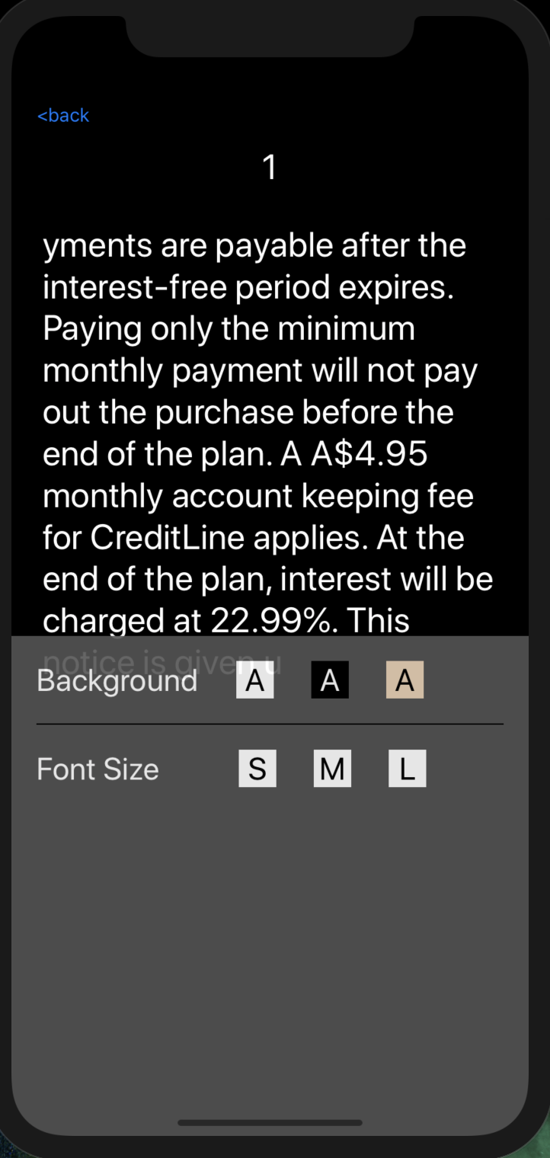
Change Background
Change background colour and picture
Tap ‘A’ button

Slide 12
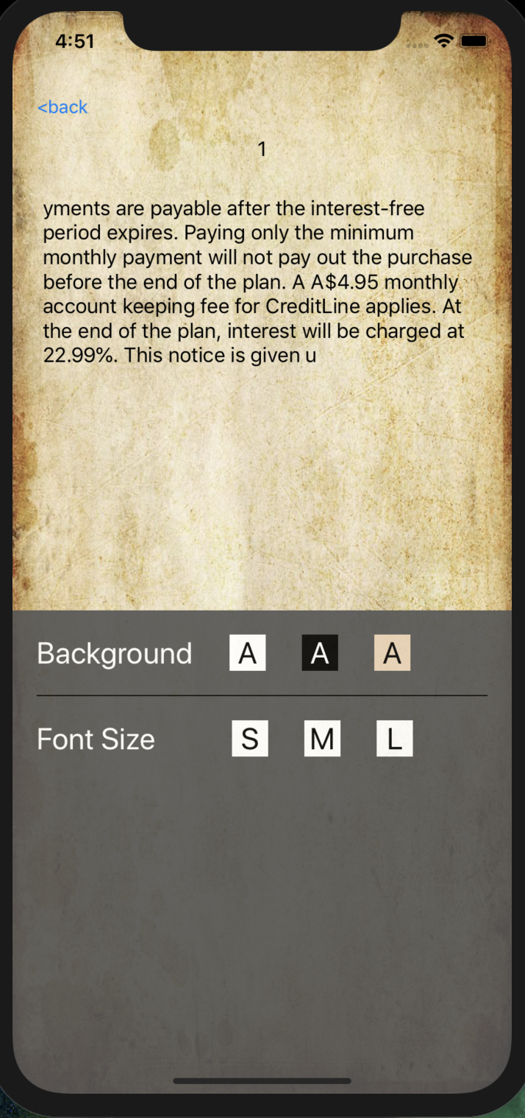
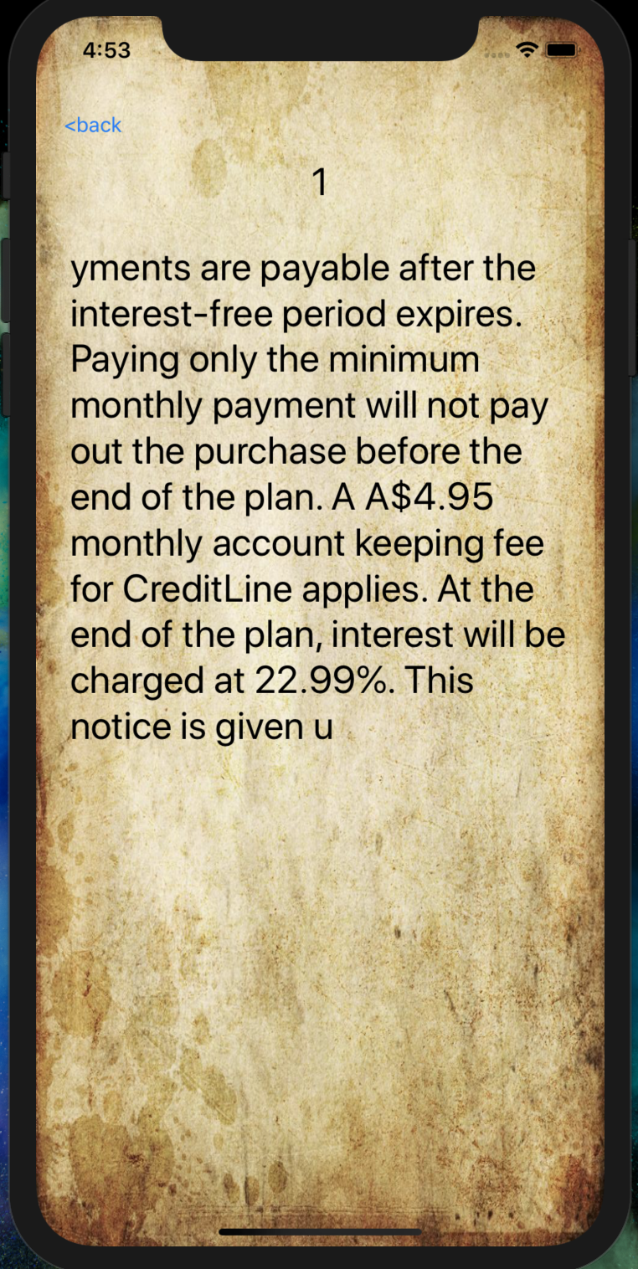
Change Font Size
Tap ‘S’ ‘M’ ‘L’ to change font size easily
It is visible for users to read the context

Slide 13
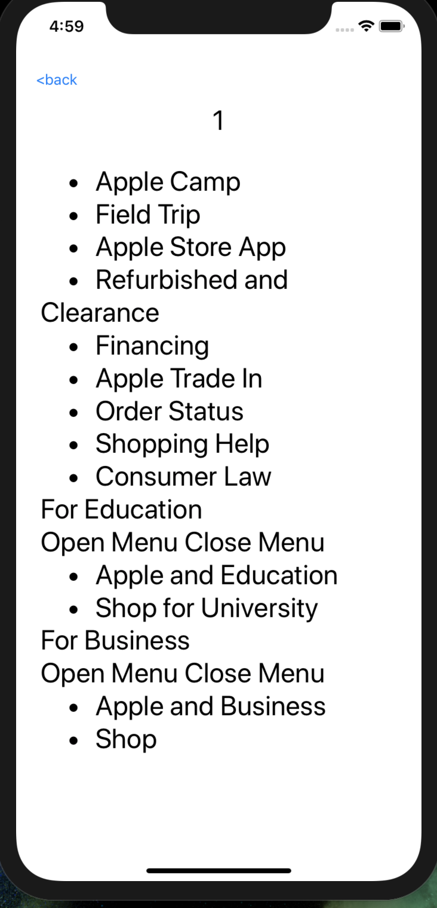
The Pages Flips
Throughout tapping the left and right screen area, change current page to the last and next page.
The users can read the entire context quickly and easily.

Slide 14
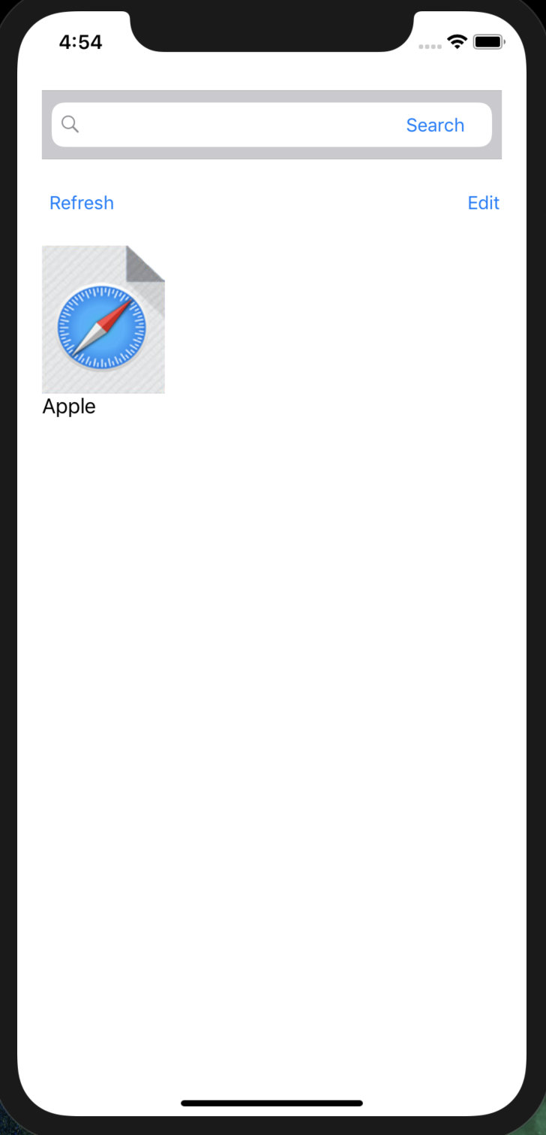
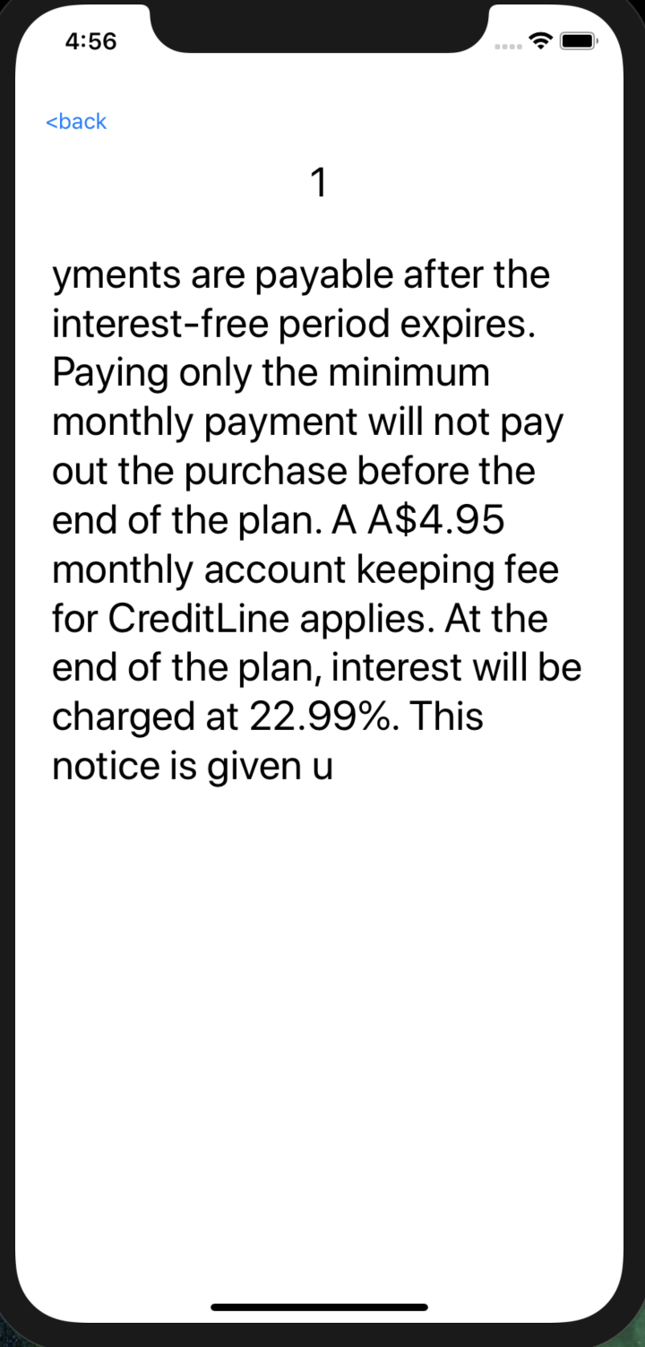
Automatic bookmark
Record the last closed page automatically
It is convenient for users to read the remaining context.

Slide 15
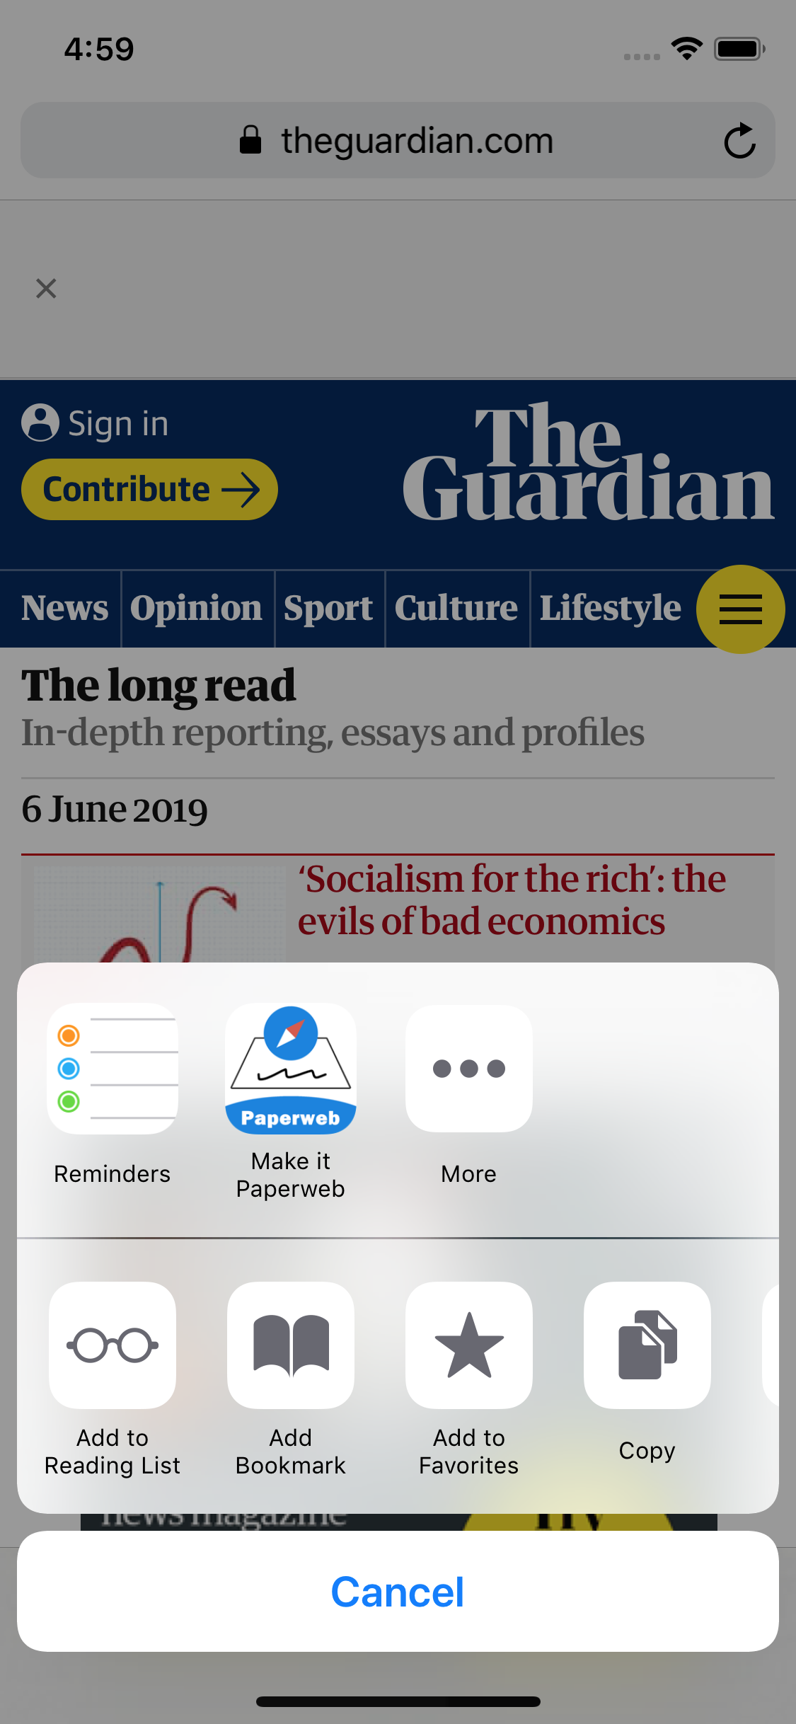

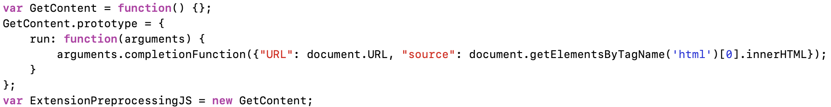
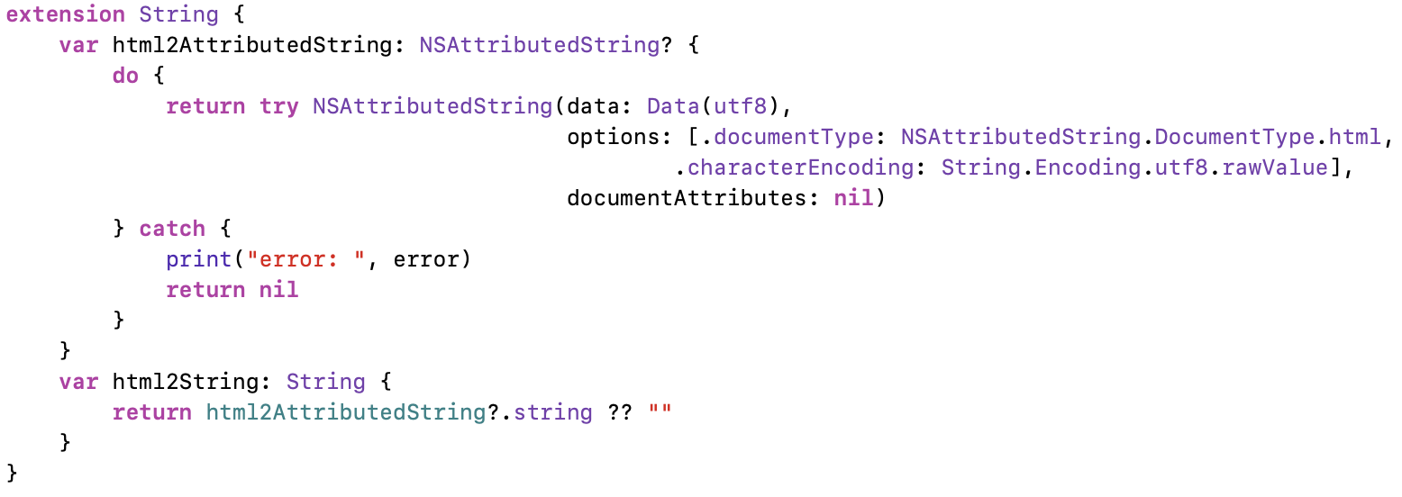
Framework - Share Extension
1. Create share extension target in the project.
2. Use JavaScript to obtain html source code.
3. Filter and extract useful text information.

Slide 16
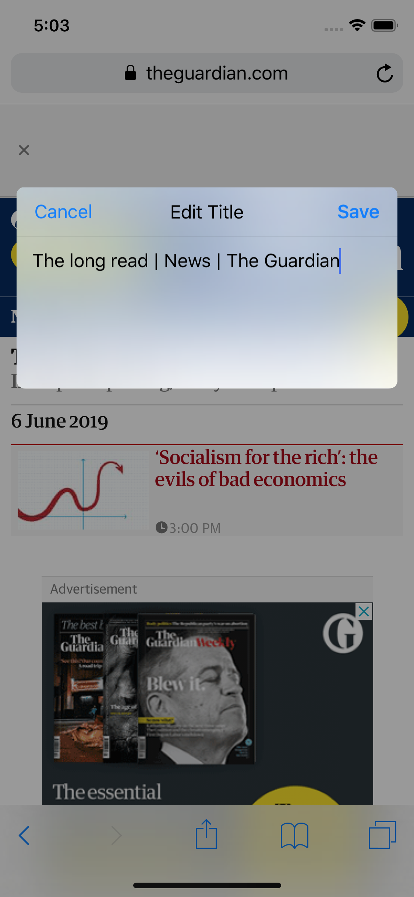
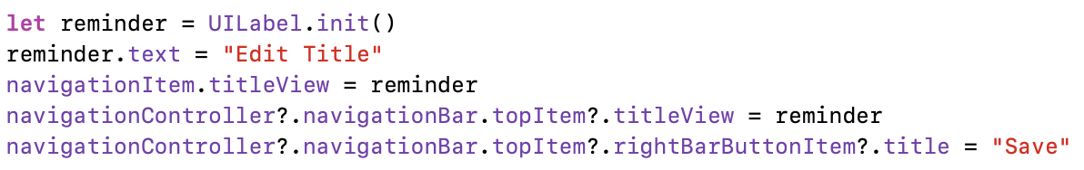
Framework - Share EXtension
4. Customise ShareView
5. Store filtered text and wait for app to display

Slide 17
Task
Allocation
Task List | Difficulty | Priority | Belonging | Assignee
1. Share Extension - Use share extension to obtain and extract text from Safari | 7 | High | Share Extension | Dayi Yang
2. Bookshelf - Add paper and with cover | 6 | High | Bookshelf | Zhaochen Lan
3. Setting - Panel initialise and background image | 3 | Middle | Reading page | Dayi Yang
4. Setting - Page turing direction | 6 | Low | Reading page | Ji Teng
5. Setting - Text size | 3 | Low | Reading page | Ji Teng
6. Setting - Store reading progress | 4 | Low | Bookshelf -> Reading page | Ji Teng
7. Bookshelf - Delete paper | 3 | Low | Bookshelf | Longyong
8. Bookshelf - Search paper | 4 | Low | Bookshelf | Longyong
9. Bookshelf - Edit paper title | 3 | Low | Bookshelf | Longyong

Slide 18

Iterative product design cycle
Week 9:
1. Decide topic
2. Task allocation
3. Database and Bookshelf view
4. Add book
Week 10: (minimum viable product)
1. Share extension
2. Reading view and setting panel initialized
3. Background image (Setting)
Week 11:
1. Text size (Setting)
2. Segue direction
3. Search Book
4. Edit book title
5. Delete book
Week 12:
1. Improve data structure and coding style
2. Prepare presentation

Slide 19
Q & A

